Slide 1
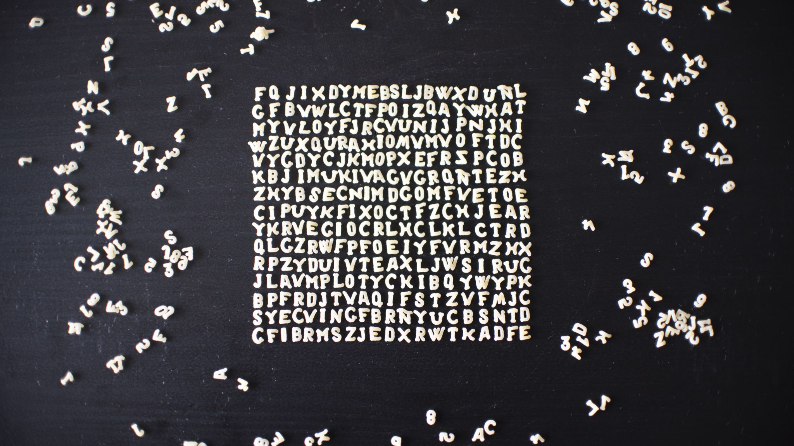
Large Language Model
Anaum Hamid

Slide 2

Large Language Models
A large language model is a trained deep-learning model that understands and generates text in a human-like fashion.
LLMs are built on neural network architectures, particularly the transformer architecture.

Slide 3
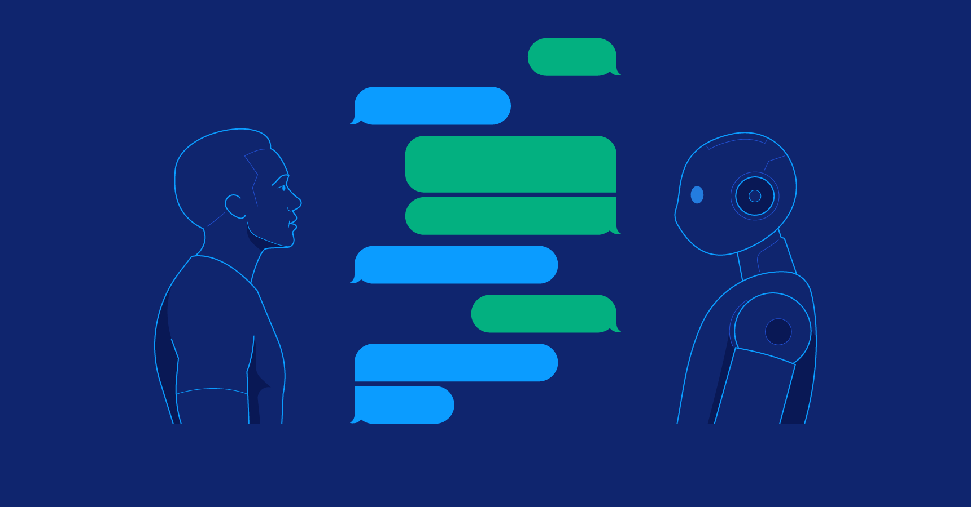

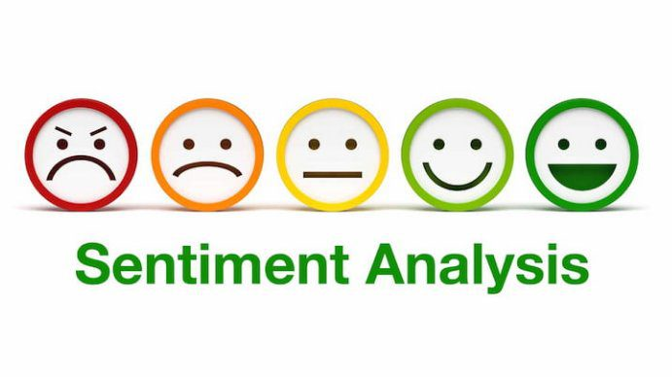
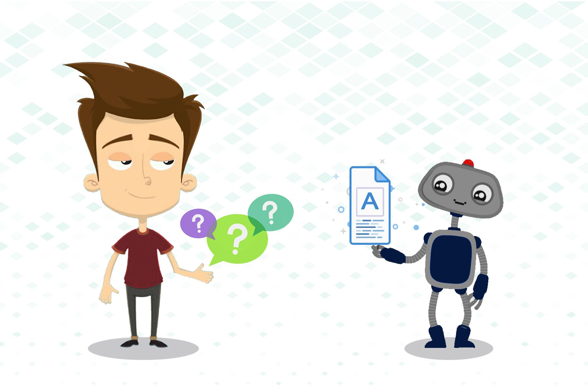
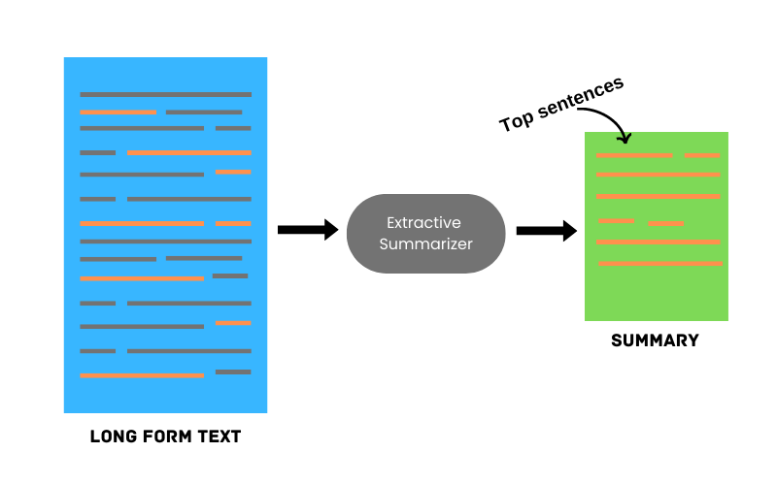
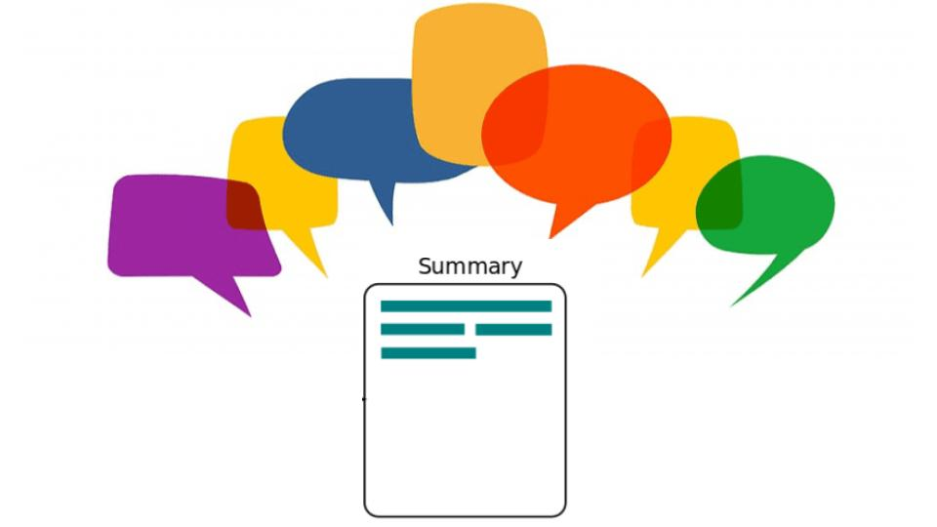

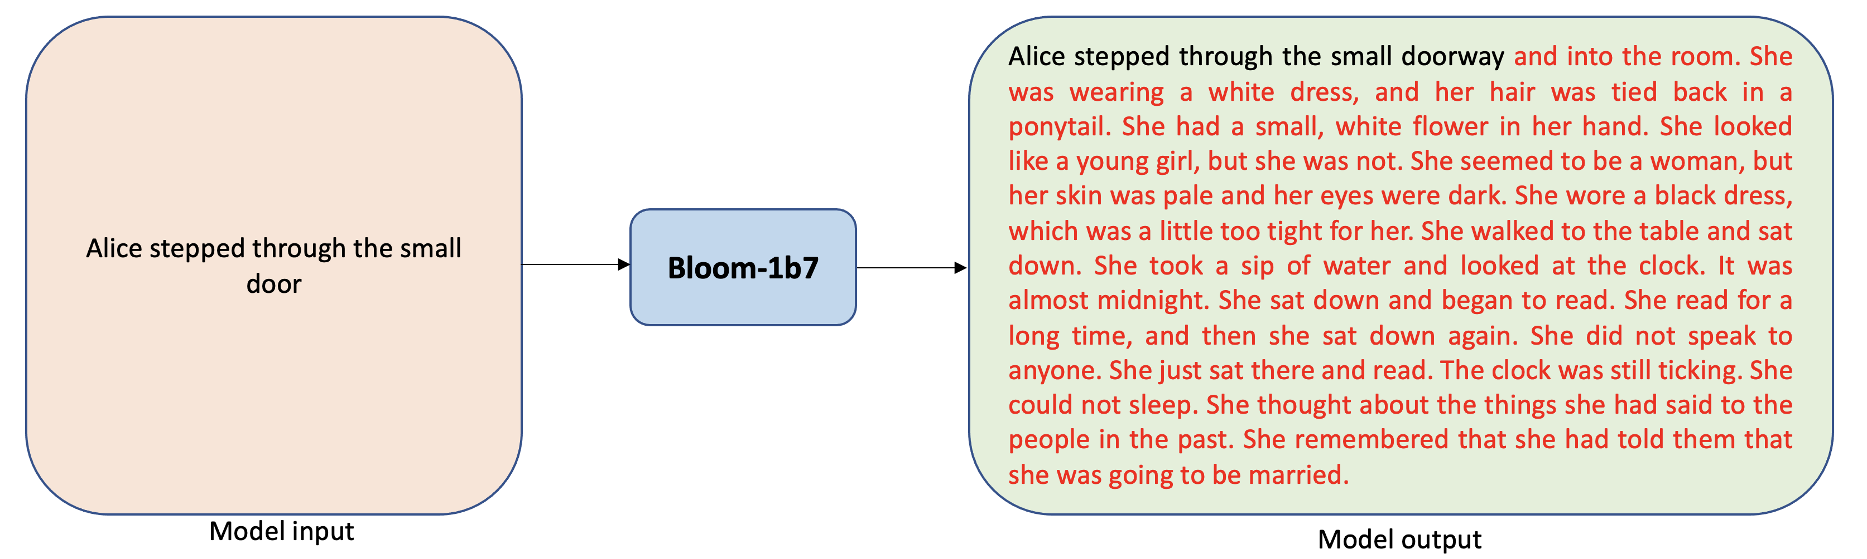
Wide Span of LLM Capabilities for NLP Task
Notes:
Language Translation
Text Generation
Text Summarization
Q/A
Chatbot Conversation/response generation/Dialogue Systems
Sentiment Analysis

Slide 4
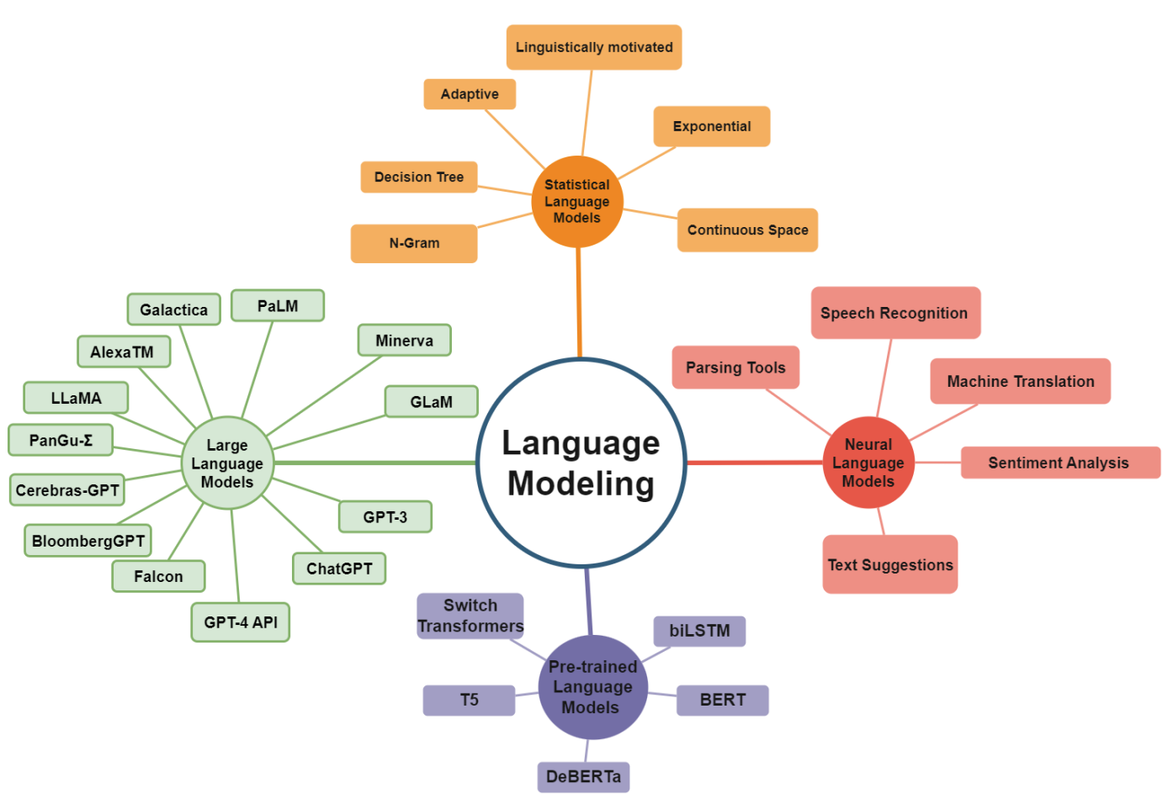
Types of language modeling.
Notes:
Statistical Language Models (SLMs): Initial phase using n-gram models to estimate the probability of the next word based on historical word patterns.
Neural Language Models (NLMs): Next stage introducing neural networks like LSTM and GRU to predict word probabilities in a sequence, enhancing contextual understanding.
Contextualized Word Embeddings (PLMs): Subsequent development involving models like ELMo and BERT, which learn contextual word representations through neural networks, capturing word meanings within context.
Pretrained Language Models (PLMs): Final stage with models like GPT-3 and GPT-4, extensively trained on vast text data, capable of excelling in diverse natural language processing tasks and fine-tuning for specific applications.

Slide 5
Types Of Language Modeling
Statistical Language Models (SLMs): Initial stage used n-grams to estimate the next word's likelihood based on past word sequences and their frequency.
Neural Language Models (NLMs): Second stage introduced neural networks like LSTM and GRU to predict next word probabilities using contextual information.
Contextualized Word Embeddings (PLMs): Third stage saw the emergence of Pre-trained Language Models (PLMs) like ELMo and BERT, using neural networks to generate context-rich word vectors for better word meaning capture.
Large Language Models (LLMs): Final stage showcased models like GPT-3 and GPT-4, extensively trained on vast text data to excel in diverse language tasks and fine-tuning for specific applications.
Notes:
LSTM= Long Short-Term Memory
GRU = Gated Recurrent Unit

Slide 6
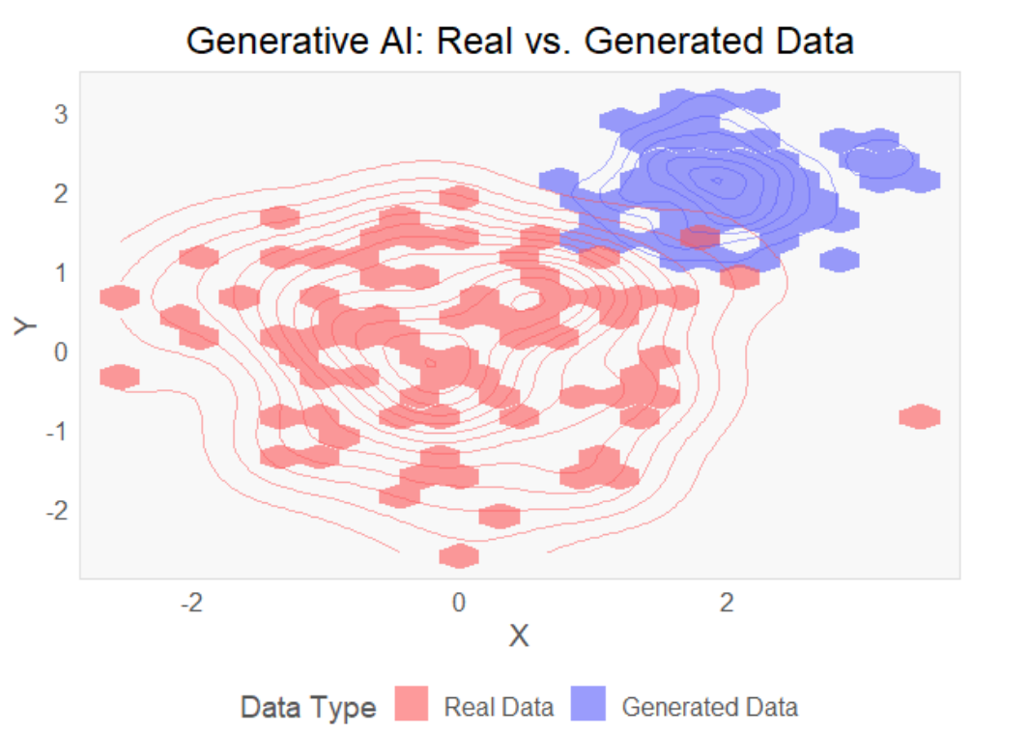
Generative AI
LLMs, a type of generative AI, specialize in producing human-like language responses from given prompts.
Generative AI systems, including image, chatbot, code, and audio generators like Midjourney, ChatGPT, CodeX, and VALL-E, create content using complex algorithms and models that mimic training data patterns.
Techniques like VAEs, GANs, and autoregressive models are employed to achieve the desired generation capabilities."
Notes:
Variational Autoencoders (VAEs),
Generative Adversarial Networks (GAN)

Slide 7
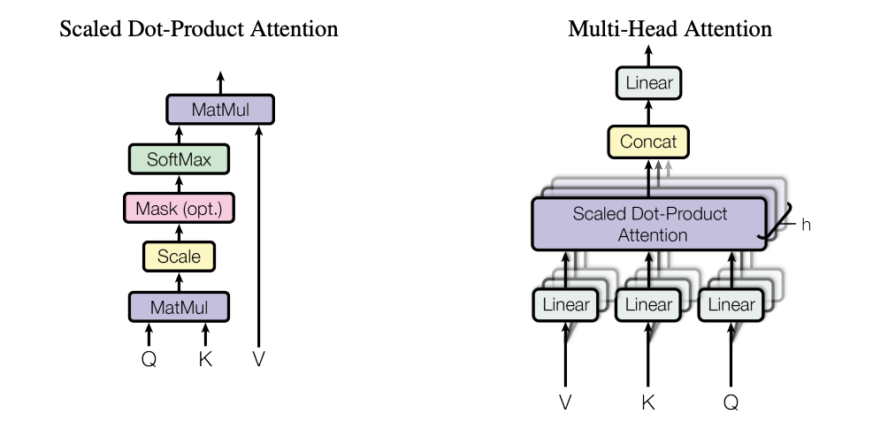
Attention Is All You Need
Attention mechanism is a technique that allows a model to focus on specific parts of an input sequence.
It works on encoder-decoder model, where the encoder first converts the input sequence into a fixed-length representation, and then the decoder uses this representation to generate the output sequence.
An attention function can be described as mapping a query and a set of key-value pairs to an output, where the query, keys, values, and output are all vectors. The output is computed as a weighted sum of the values, where the weight assigned to each value is computed by a compatibility function of the query with the corresponding key.

Slide 8

Transformer
Transformer is an architecture for transforming one sequence into another one with the help of two parts (Encoder and Decoder).
The Encoder is on the left and the Decoder is on the right. Both Encoder and Decoder are composed of modules that can be stacked on top of each other multiple times (Nx).
Modules consist mainly of Multi-Head Attention and Feed Forward layers. The inputs and outputs (target sentences) are first embedded into an n-dimensional space.
Give every word/part in our sequence a relative position since a sequence depends on the order of its elements. These positions are added to the embedded representation (n-dimensional vector) of each word.

Slide 9
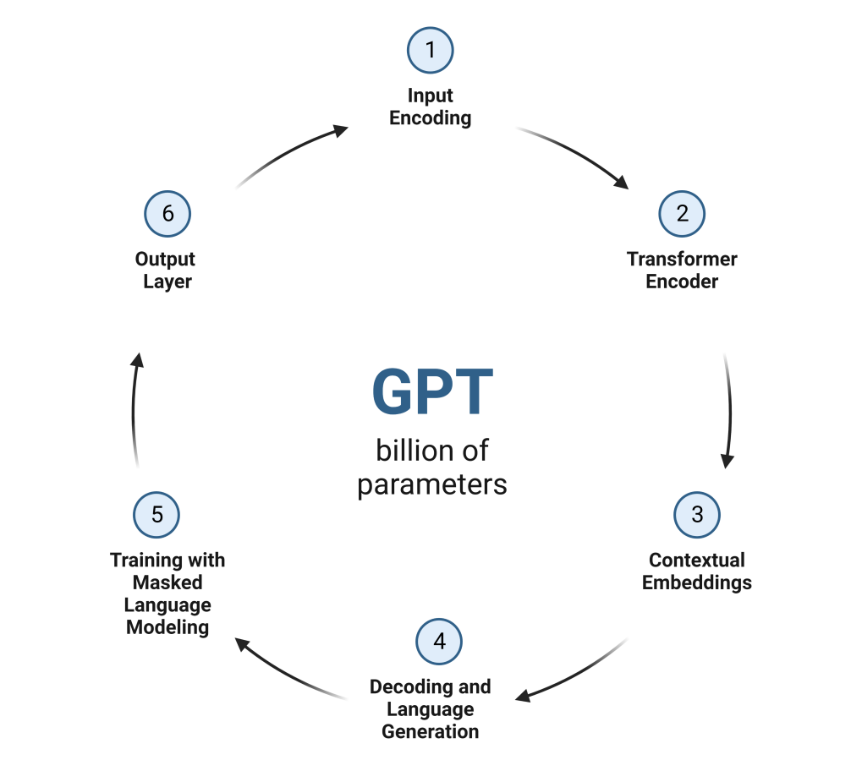
Generative Pre-trained Transformers
The transformer-based architecture is a type of neural network. It uses a stack of self-attention layers to learn long-range dependencies in text. Self-attention is a mechanism that allows the model to learn the importance of each word in the input sequence, regardless of its position.

Slide 10

Generative Pre-trained Transformers
Input Encoding: GPT model takes token sequences as input, converting each into a high-dimensional vector using an embedding layer.
Transformer Encoder: Multiple layers of transformer encoders compose the GPT model. Each layer contains self-attention for capturing word dependencies and feed-forward networks to process representations.
Contextual Embeddings: Token representations are updated as they pass through encoder layers, incorporating context from surrounding tokens.
Decoding and Language Generation: After encoding, GPT generates text by predicting the next token's probability using softmax, considering context.
Training with Masked Language Modeling: GPT's pre-training involves Masked Language Modeling (MLM), masking tokens and training to predict them from context. This improves coherence and contextual understanding.
Output Layer: The 6th layer signifies the model's output.

Slide 11
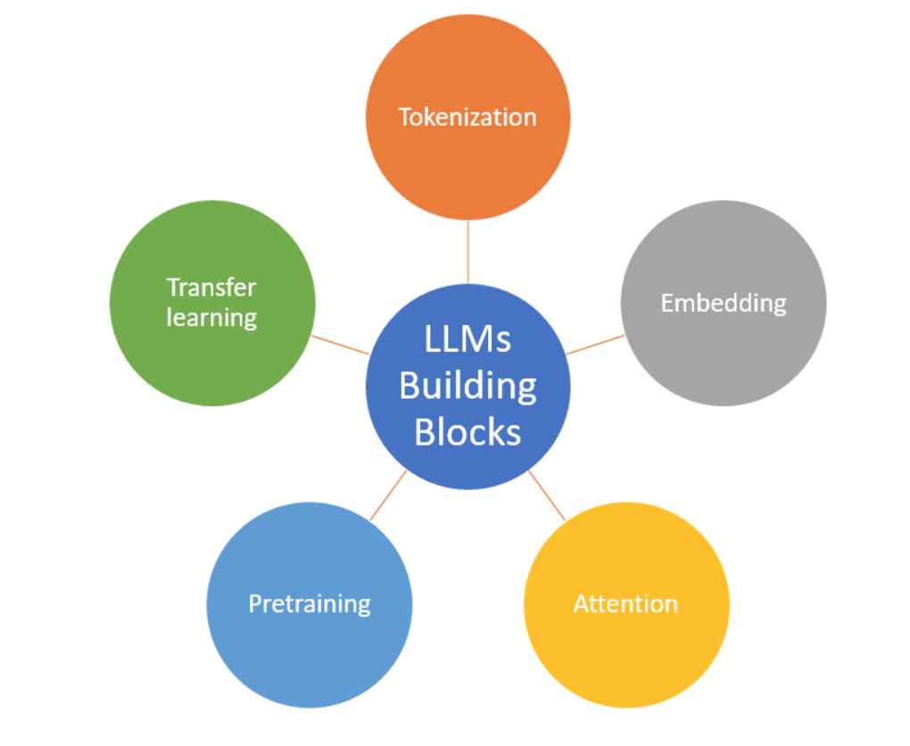
LLM Building Blocks
Tokenization: Converts text sequences into model-friendly units (tokens). LLMs employ subword algorithms like BPE or WordPiece, balancing vocabulary size and text representation.
Embedding: Creates continuous vector representations (embeddings) of tokens, capturing their meanings in a high-dimensional space. Learned during training, they capture complex relationships among words.
Attention: Utilizes mechanisms like self-attention in transformers to assign weights to tokens, highlighting vital information in a context. Enables focusing on relevant details and capturing language nuances.
Pre-training: Involves training LLMs on extensive unsupervised data to learn language patterns and relationships. The model is then fine-tuned for specific tasks, reducing the need for large labeled datasets.
Transfer Learning: Transfers knowledge from pretraining to new tasks by fine-tuning pretrained models on smaller datasets. Benefits from general language knowledge, reducing the requirement for extensive task-specific training.

Slide 12


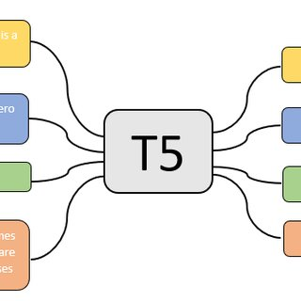
Types of LLMs
Autoregressive Language Models (e.g., GPT): Autoregressive models generate text by predicting the next word in a sequence given the previous words. They are trained to maximize the likelihood of each word in the training dataset, given its context.
Autoencoding Language Models (e.g., BERT): Autoencoding models, on the other hand, learn to generate a fixed-size vector representation (also called embeddings) of input text by reconstructing the original input from a masked or corrupted version of it. They are trained to predict missing or masked words in the input text by leveraging the surrounding context.
Combination of autoencoding and autoregressive such as Text-to-Text Transfer Transformer.

Slide 13
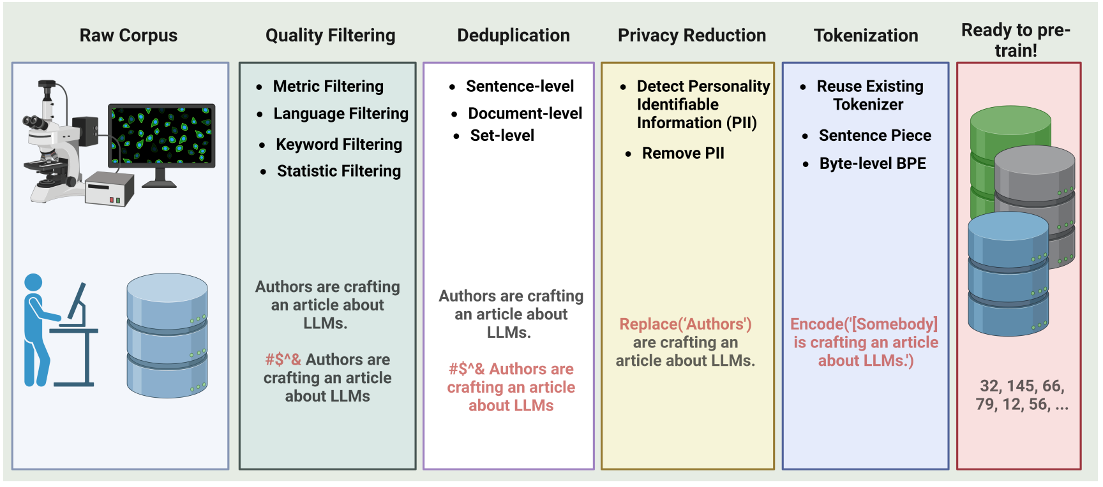
Data processing pipeline for pre-training corpus preparation
Notes:
Data Collection: Gather text data from general and specialized sources. Data Preprocessing: Cleanse and refine data, removing noise and redundancy.
Quality Filtering →Data Quality Enhancement: Employ techniques like language, statistic, and keyword filtering to eliminate low-quality content.
Deduplication →Duplicate Data Handling: Detect and remove duplicate content to enhance model diversity and stability.
Privacy Reduction →Privacy Measures: Address privacy concerns by redacting personally identifiable information from web-based data.
Tokenization →Text Segmentation: Divide raw text into tokens, which serve as input for language models.
Fine-Tuning →Task-Specific Training: Train the model on specific tasks or domains with labeled examples.

Slide 14

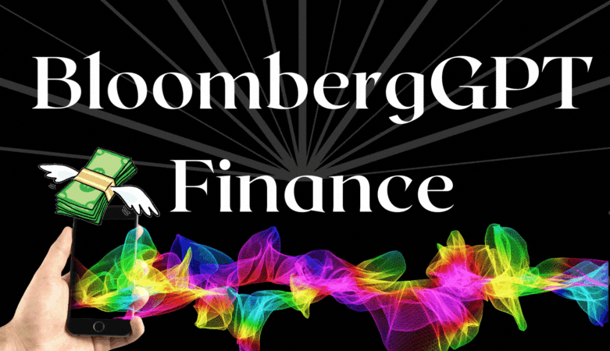
LLM in Finance
BloombergGPT, a massive 50 billion-parameter language model, has transformed financial NLP tasks like news classification, entity recognition, and question answering. Trained on extensive financial data, it revolutionizes customer service by efficiently addressing queries and offering exceptional financial guidance.
FinGPT is an open-source LLM tailored for finance.

Slide 15
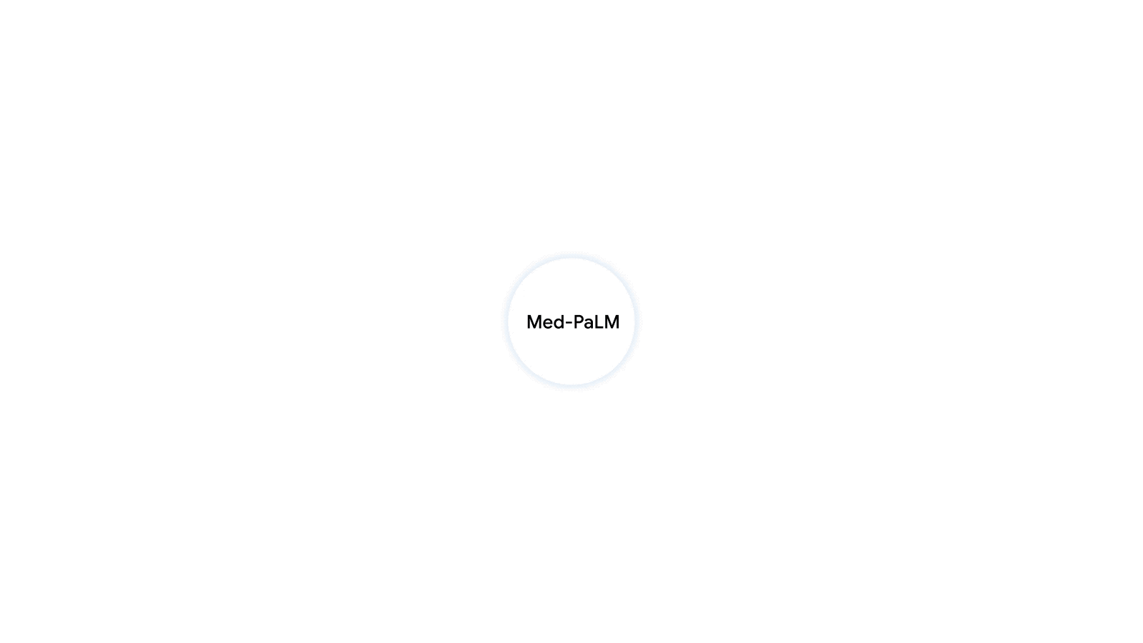
LLM in Health Care
Med-PaLM M is a large multimodal generative model that flexibly encodes and interprets biomedical data including clinical language, imaging, and genomics with the same model weights.

Slide 16
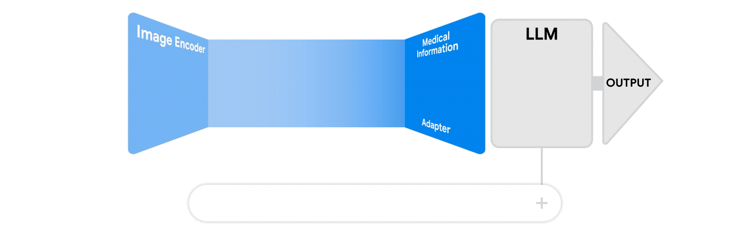
LLM in Health Care - XrayGPT

Slide 17

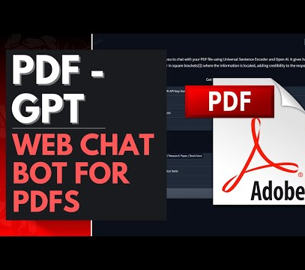
LLM in Education
PDFGPT uses the GPT-3 model to generate responses to user queries. PDFGPT can be used to extract information from PDF files, answer questions about the content of PDF files, and generate summaries of PDF files.
GitHub Copilot is an AI-powered code completion tool developed by GitHub in collaboration with OpenAI. It utilizes OpenAI’s GPT-3 language model to assist developers in writing code more efficiently.

Slide 18
Machine Translation
Task: Translate between languages
Use Cases: This is particularly valuable for business, travel, medical science, education, and law, facilitating translation of documents across languages. Additionally, it aids language learning for students.
Technique: Neural Machine Translation (NMT)
Source: Effective Approaches to Attention-based Neural Machine Translation

Slide 19
Sentiment Analysis
Task : Determine tone of text or conversation
Use Cases: This can be used for the task of market research, customer analysis and social media monitoring.
Technique: Convolutional and recurrent neural network
Source: Attention-based sentiment analysis using convolutional and recurrent neural network.

Slide 20
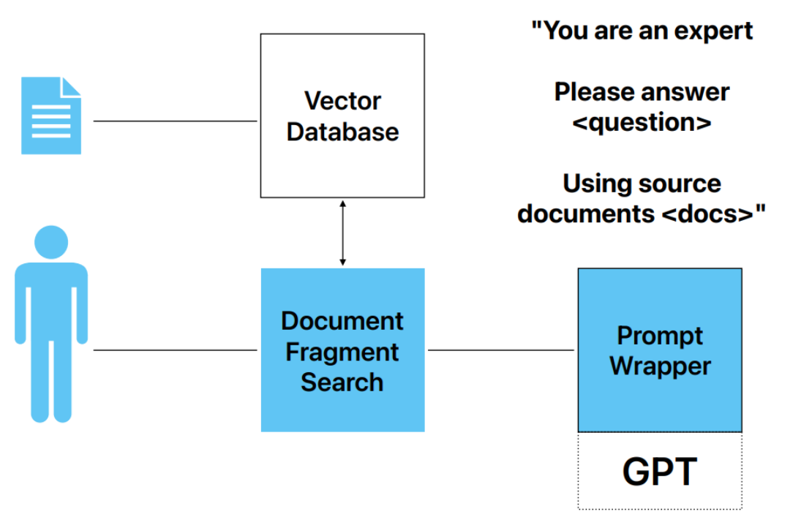
Question-Answering
Task: Answer questions for a user query
Use Cases: Search engines, Digital Libraries, Media Search (image retrieval, New Search), Customer Support.

Slide 21
Natural Language Parsing
Natural Language Parser uses the grammar rules to verify the inputted text is valid or not syntactically. The parser helps us to get the meaning of the provided text. It helps us to analyze the syntax error in the text so, the parsing process is also known as the syntax analysis or the Syntactic analysis
Uses Case : Information Extraction, Text Mining, Dialogue system and Summarization
Source: Deep Learning for Natural Language Parsing.

Slide 22
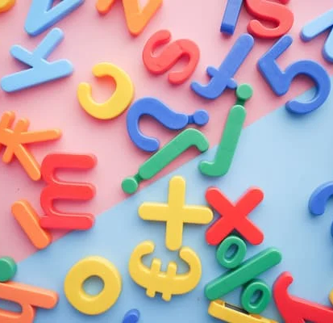
Natural Language Generation
Uses Cases: Chat Bot, Voice Assistant, Ai blog writer,
Technique: Generative Adversarial Network.

Slide 23
References
Hadi, Muhammad Usman; tashi, qasem al; Qureshi, Rizwan; Shah, Abbas; muneer, amgad; Irfan, Muhammad; et al. (2023). A Survey on Large Language Models: Applications, Challenges, Limitations, and Practical Usage. TechRxiv. Preprint. https://doi.org/10.36227/techrxiv.23589741.v1
https://vitalflux.com/large-language-models-concepts-examples/
https://www.analyticsvidhya.com/blog/2023/03/an-introduction-to-large-language-models-llms/#General_Architecture

Slide 24

Thank you

